Slide 1
Chapter Cache
Benjamin Hart, Hye Chan Lee, Faeren Madza, Daniel Park, Anwesha Pradhananga
Say hello to budget-friendly wisdom
Notes:
Show the books
When we asked our

Slide 2
DEMO

Slide 3
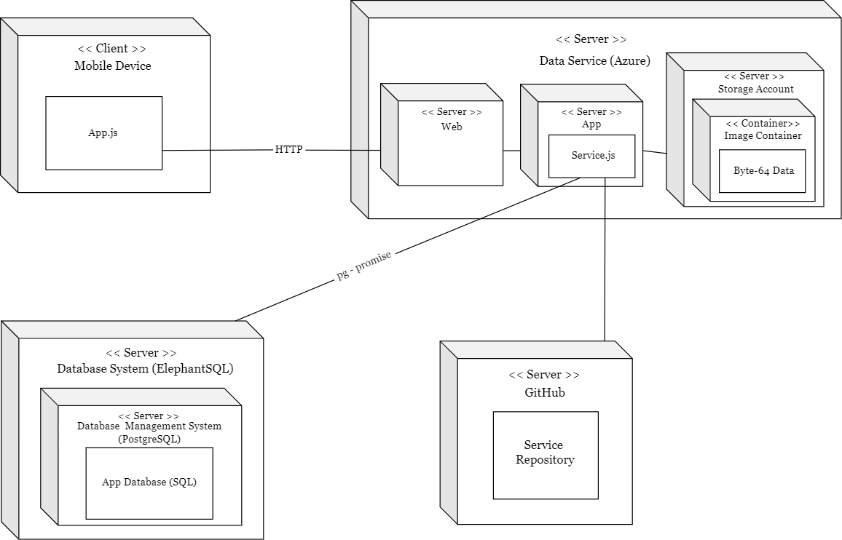
Deployment Diagram
Notes:
Faeren - ~1 minute

Slide 4
Assessments
Allows reusing books - Calvin focused
Builds personal connection
Postman’s idea ‘ technology giveth and taketh away’
Phone application instead of a website
Possibility to become obsolete due to E-books
Notes:
-As stated earlier many books are unused which is where are app comes in
-Many social apps limit personal interaction, we combat that
-Yet another app, limits user base
- Many student now use E-Books

Slide 5
FutuRE WORK
Forgot Password screen implementation
Email authentication
Delete Books from the database (manage piling books)
Search function optimization - Fuzzy Search
Hosting the app to different universities
Notes:
Forgot password screen implementation - allow for users who forget passwords to get new ones
Book database management - ? (what is piling books?)
Search function optimization - Adding error handling (fuzzy search), more categories(?), etc
Hosting the app to different universities - We want to expand this app to other universities

Slide 6
Thanks

